Slide 1
Treatment

Slide 2
The initial presentation may be to the family physician or any number of subspecialists, including a dermatologist, rheumatologist, nephrologist, otolaryngologist, or pulmonologist. Most patients are treated by a rheumatologist experienced with these diseases. The rheumatologist works with the patient’s family physician, who monitors the disease progression and complications of treatment.

Slide 3
The treatment includes three phases:
induction of remission,
maintenance,
and treatment of relapse.
The severity and extent of the disease divides patients into three groups:
those with localized or early disease,
those with generalized disease with threatened organ involvement,
and those with severe or life-threatening disease.
Notes:
Тяжесть и степень заболевания делит пациентов на три группы:
те с локализованным или ранней стадии болезни,
с генерализованным заболеванием с участием находящихся под угрозой органов,
и тех, кто страдает тяжелой или опасной для жизни болезнью.

Slide 4
For patients with localized and early disease, treatment with steroids and methotrexate or cyclophosphamide is recommended for induction of remission.
Methotrexate may be associated with a higher relapse rate.
Evidence of relapse or disease progression despite treatment with methotrexate requires the use of cyclophosphamide.
Initial treatment of generalized organ-
threatening disease should include steroids and cyclophosphamide.
Notes:
Доказательства рецидива или прогрессирования заболевания, несмотря на лечение метотрексатом, требуют использования циклофосфамида.

Slide 5
Cyclophosphamide can be administered as an intravenous infusion every two weeks (and later every three weeks), or as a daily low dose oral treatment. There is no difference in remission rates or relapse risk between oral and intravenous regimens.
Steroids are given as daily oral prednisone (1 mg per kg, up to 60 mg daily). Pulsed intravenous steroids can be given just before or with the first two intravenous pulses of cyclophosphamide.
Notes:
Там нет никакой разницы в ремиссиях или рецидивов риски между устными и внутривенными режимами.

Slide 6
Patients presenting with severe life- hreatening disease (severe renal failure or pulmonary hemorrhage) should be treated with cyclophosphamide (pulsed intravenous or continuous oral) and steroids, with adjuvant plasma exchange.

Slide 7
Maintenance therapy with either azathioprine or methotrexate is initiated if remission has occurred after three to six months of induction therapy.
Steroid dosage is tapered during this phase. Patients may need to continue maintenance treatment for up to 24 months.
Maintenance treatment for up to five years is recommended in patients with Wegener granulomatosis and patients who remain ANCA-positive. Some patients may require treatment indefinitely.
Notes:
поддерживающая терапия. У некоторых пациентов может потребоваться лечение на неопределенный срок.

Slide 8
Disease relapse may occur anytime after the remission. Serial measurements of ANCA are not closely associated with disease activity; therefore, treatment should not be solely guided on the basis of an increase in ANCA. Relapsing disease can be managed with an increase in steroid dose, optimization of the current immunosuppressant, or combination of an immunosuppressant with an increased dose of steroid.
Notes:
Рецидив заболевания может произойти в любое время после ремиссии. Последовательные измерения ANCA не тесно связаны с активностью заболевания; поэтому лечение не должно основываться исключительно на увеличении ANCA. Возвратный заболевание может управляться с увеличением дозы стероидов, оптимизации текущей иммунодепрессанта, или комбинации иммунодепрессанта с увеличением дозы стероидов.

Slide 9
Novel biologic therapies targeted against specific components of the immune system are being used for systemic vasculitis, particularly for patients in whom conventional therapy has failed. Agents such as infliximab (Remicade; human chimeric anti-tumor necrosis factor [TNF]-α monoclonal antibody), etanercept (Enbrel; fusion protein of the p75 TNF-α receptor and immunoglobulin G1), adalimumab (Humira; fully humanized IgG1 anti-TNF-α monoclonal antibody), rituximab (Rituxan; anti-CD20 chimeric mouse/ human monoclonal antibody), anakinra (Kineret; recombinant interleukin-1 receptor antagonist), and intravenous immune globulins may be used in refractory disease.

Slide 10
Patients with systemic vasculitis are at increased risk of comorbidities resulting from disease-related end organ damage and immunosuppressive therapy. The immunosuppressive medications used for the treatment of systemic vasculitis cause serious adverse effects during the first year of therapy. Steroids and cyclophosphamide predispose patients to life-threatening infections. Cyclophosphamide can cause hemorrhagic cystitis, ovarian and testicular failure, and bladder cancer. Diagnosis and treatment of these complications are coordinated with the family physician.

Slide 11
Recommendations regarding detecting and preventing these complications include use of mesna (Mesnex) for protecting against urothelial toxicity of cyclophosphamide, antifungal prophylaxis, prophylaxis against Pneumocystis jiroveci, consideration for Staphylococcus aureus treatment, screening for cervical malignancy, and counseling about infertility with cyclophosphamide. Adverse effects of long-term steroid use (e.g., diabetes mellitus, osteoporosis, cataract) should be assessed. Vitamin D and calcium prophylaxis are recommended in patients on long-term therapy with steroids.

Slide 12
Management of systemic vasculitis is complicated. Educating patients about signs and symptoms, and monitoring typical adverse effects are helpful. Many patients will have a relatively benign, self-limited course, especially if the disease is limited to the skin; however, for patients with aggressive disease, such as ANCA- associated small vessel vasculitis, it is imperative to begin treatment without delay. The multisystem involvement in systemic vasculitis necessitates a multi disciplinary team approach to patient care. Recent advances in therapy have led to considerably better outcomes in patients with vasculitis.

Slide 13
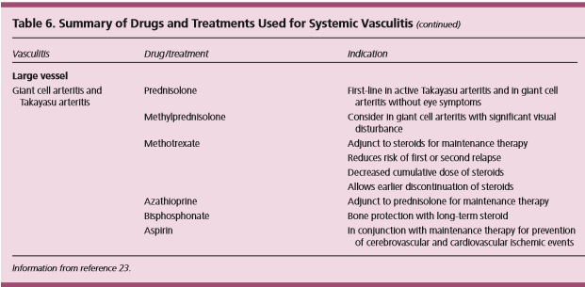

Slide 14
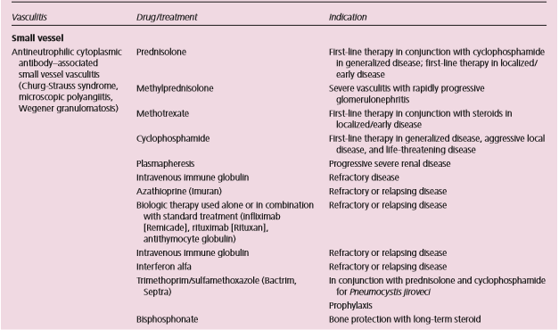

Slide 15
